Slide 1

ADAPTIVE TECHNOLOGY FOR AUTISM SUPPORT
by
PRANEESHA V
Roll No. 224G1A0573
RAJESHWARI K
Roll No. 224G1A0579
VENKATA VENU K
Roll No. 224G1A05C3
Under the guidance of
Mr. G.Ganesh M.Tech. Assistant Professor
Department of Computer Science and Engineering
Srinivasa Ramanujan Institute of Technology
Autonomous
Rotarypuram Village, B K Samudram Mandal, Ananthapuramu – 515701.
2025-2026

Slide 2
QUERIES FROM REVIEW ZERO
ADAPTIVE TECHNOLOGY FOR AUTISM SUPPORT
What is the main objective of the project?
Is this web application or mobile application?
What tech stack you are going to use?
Who are the intended end users of the application?
Srinivasa Ramanujan Institute of Technology

Slide 3
Title Explanation
ADAPTIVE TECHNOLOGY FOR AUTISM SUPPORT NETWORKSADA
“ADAPTIVE TECHNOLOGY FOR AUTISM SUPPORT” reflects the core objectives of the project:
Adaptive:The system adjusts activities and difficulty based on user interaction and performance.
Technology:Uses a Flutter-based application with Firebase backend and lightweight AI tools.
Autism Support:Focuses on assisting children with autism in emotional awareness, attention, and social interaction.
Srinivasa Ramanujan Institute of Technology

Slide 4
Contents
ADAPTIVE TECHNOLOGY FOR AUTISM SUPPORT
Abstract
Introduction
Software Requirements
Datasets/Modules
Implementation
Outputs
Conclusion
References
Srinivasa Ramanujan Institute of Technology

Slide 5
Abstract
ADAPTIVE TECHNOLOGY FOR AUTISM SUPPORT
A cross-platform assistive application designed to support emotional and social development in children with autism.
Existing assistive solutions lack adaptive, personalized, and privacy-focused digital support.
The system uses a Flutter-based interface, Firebase backend services, and rule-based adaptive logic with pre-trained AI models.
The application enables structured interaction, progress tracking, and caregiver involvement in a safe environment.
The project establishes an ethical and scalable foundation for adaptive autism support with future AI enhancements.
Srinivasa Ramanujan Institute of Technology

Slide 6
Introduction
ADAPTIVE TECHNOLOGY FOR AUTISM SUPPORT
Autism Spectrum Disorder affects communication, emotional regulation, and social interaction in children.
Traditional therapy methods are limited by accessibility, cost, and time constraints.
Technology can provide a safe, engaging, and repeatable learning environment for skill development.
This project was chosen to address a real-world social problem using adaptive technology.
The focus is on supportive assistance and progress monitoring, not medical diagnosis.
The system encourages caregiver and therapist involvement through structured feedback and reports.
The application is designed to be child-friendly, non-intrusive, and privacy-aware.
Srinivasa Ramanujan Institute of Technology

Slide 7
Software Requirements
ADAPTIVE TECHNOLOGY FOR AUTISM SUPPORT
Development Tools / IDEs
Visual Studio Code
Android Studio
Programming Languages
Python
Flutter SDK
Firebase
Cloud Firestore
Srinivasa Ramanujan Institute of Technology

Slide 8
Dataset / Modules:
ADAPTIVE TECHNOLOGY FOR AUTISM SUPPORT
Datasets
Pre-trained emotion recognition dataset
Emotion label set (Happy, Sad, Angry,Disgust,Surprise,Neutral, etc.)
User Module
Dataset: Stores registered user information.
Fields: User ID, Name, Email, Role (Child/Parent/Therapist), Login Credentials.
Purpose: Handles user registration, authentication, and role-based access.
Emotion Detection Module
Dataset: Stores detected emotion data.
Fields: Emotion Label, Confidence Score, Timestamp, Child ID.
Purpose: Tracks emotional states and supports adaptive responses.
Srinivasa Ramanujan Institute of Technology

Slide 9
Dataset / Modules:
ADAPTIVE TECHNOLOGY FOR AUTISM SUPPORT
Child Profile Module
Dataset: Stores child-specific profile details.
Fields: Child ID, Age, Parent ID, Assigned Therapist ID.
Purpose: Manages child information and links activities to the child profile.
Therapeutic Games Module
Dataset: Stores game interaction and performance data.
Fields: Game ID, Score, Level, Duration, Child ID.
Purpose: Improves cognitive, emotional, and social skills through games.
Progress Tracking Module
Dataset: Stores session-wise progress reports.
Fields: Session ID, Emotion Summary, Game Performance, Date.
Purpose: Helps parents and therapists monitor improvement over time.
Srinivasa Ramanujan Institute of Technology

Slide 10
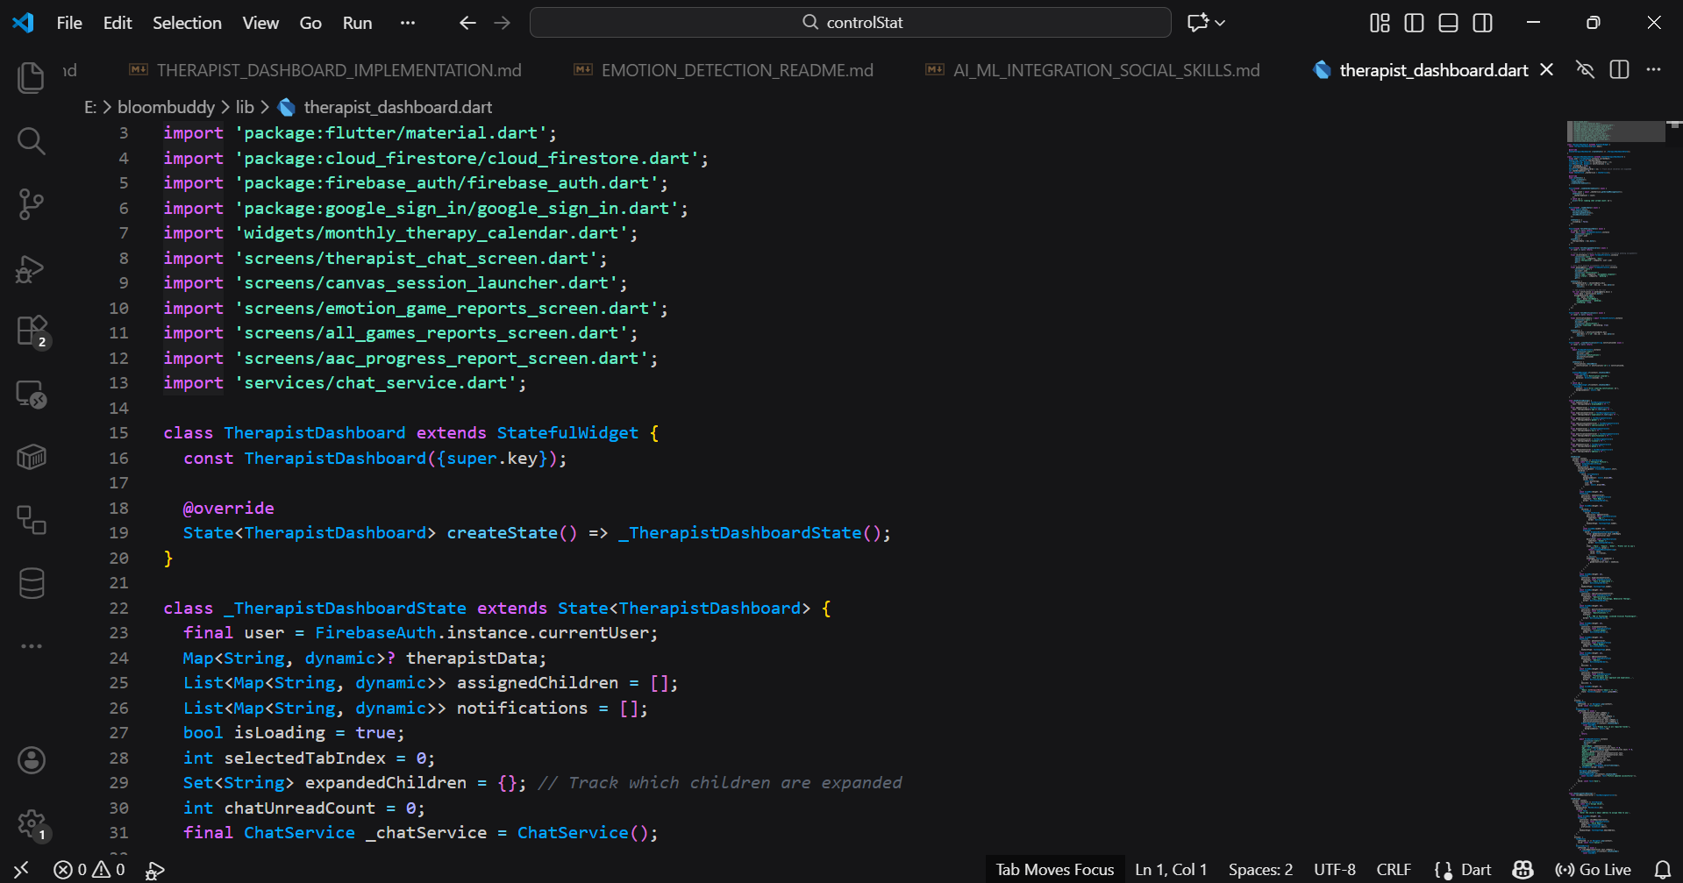
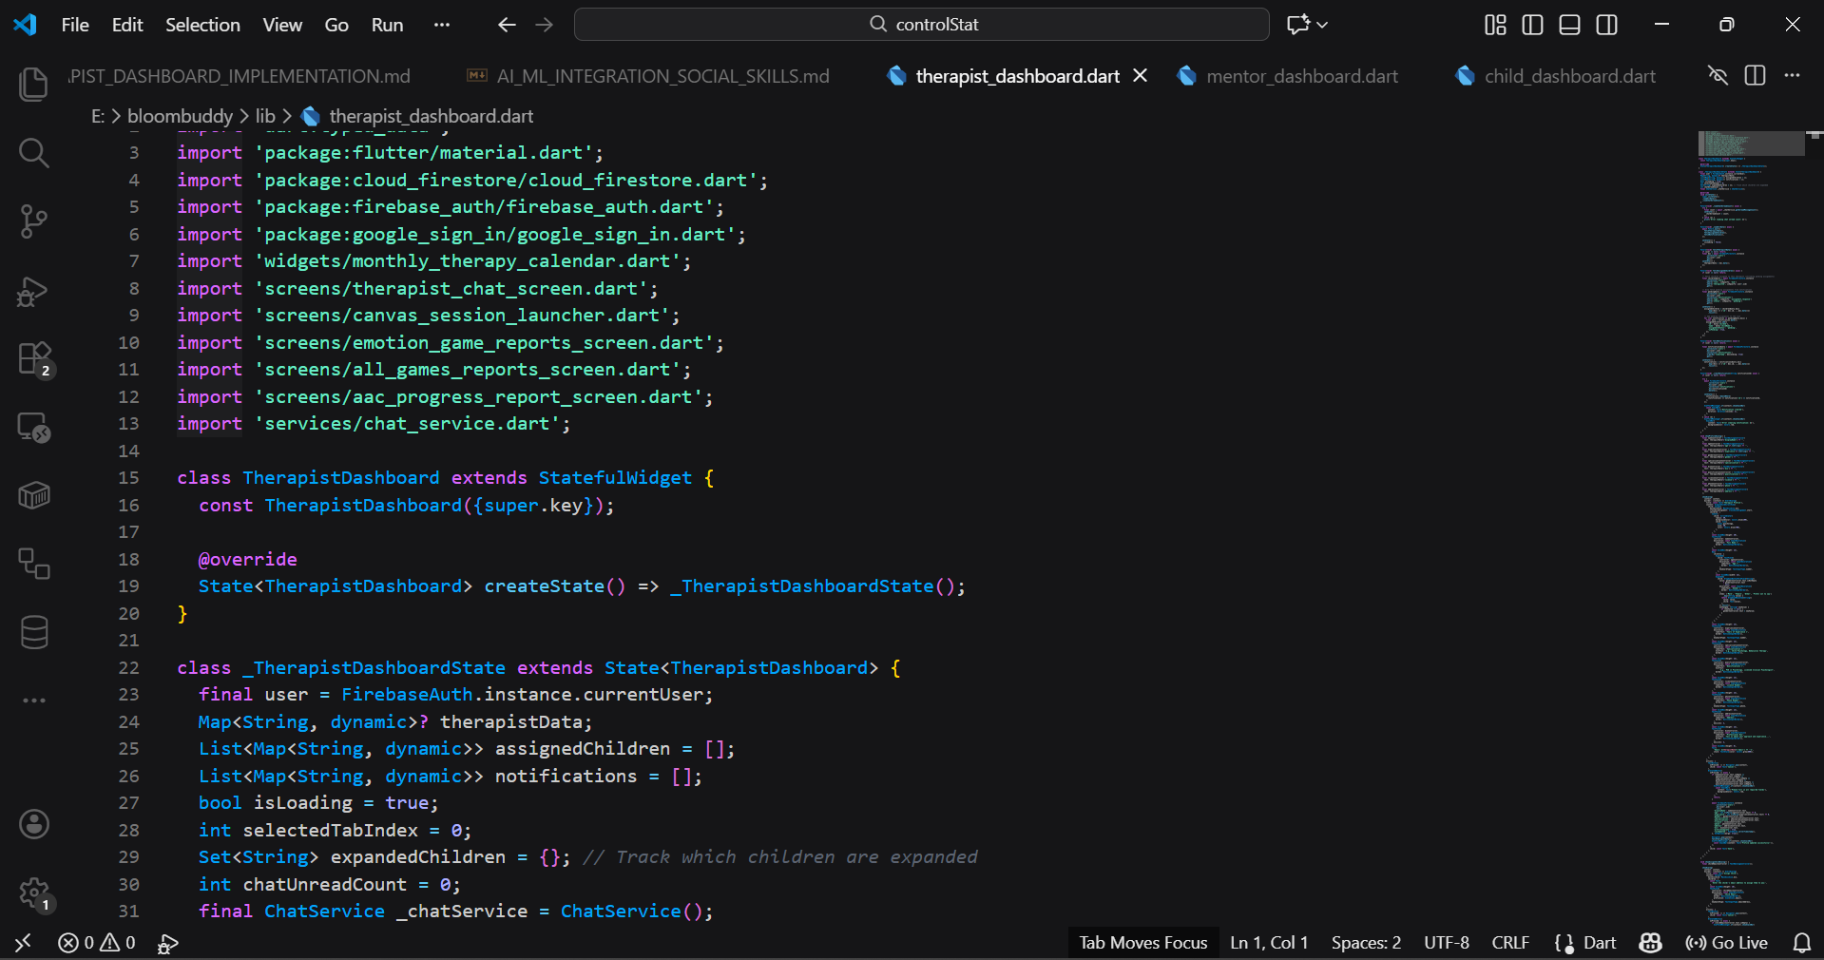
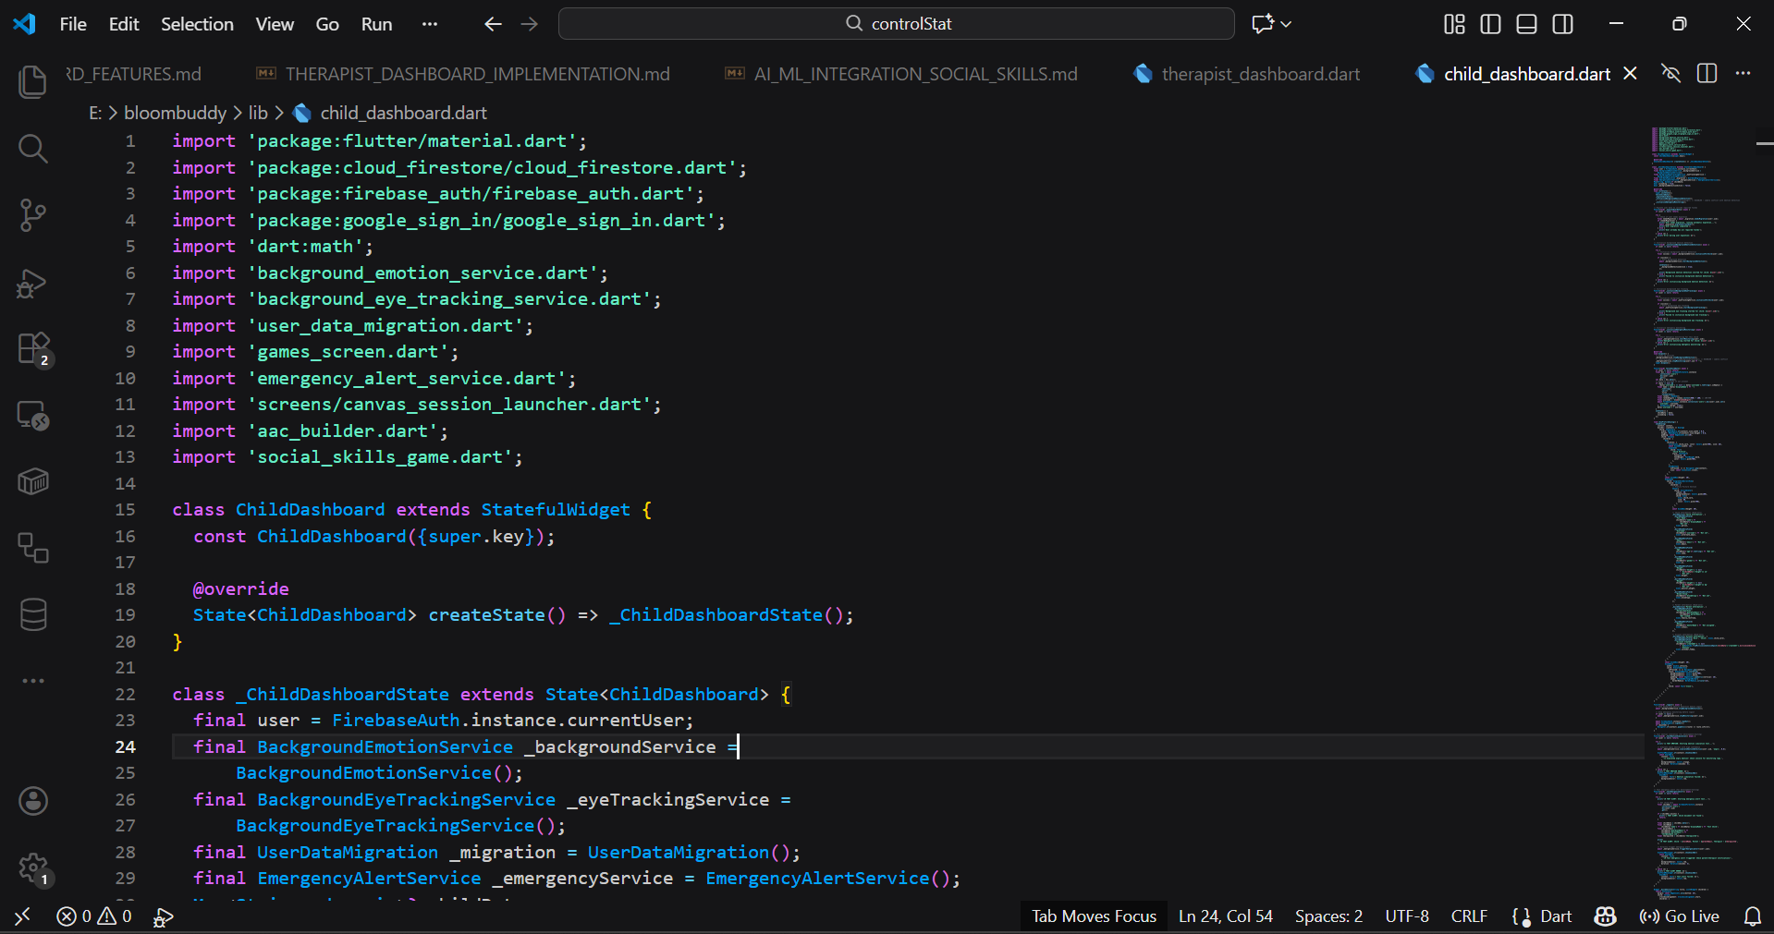
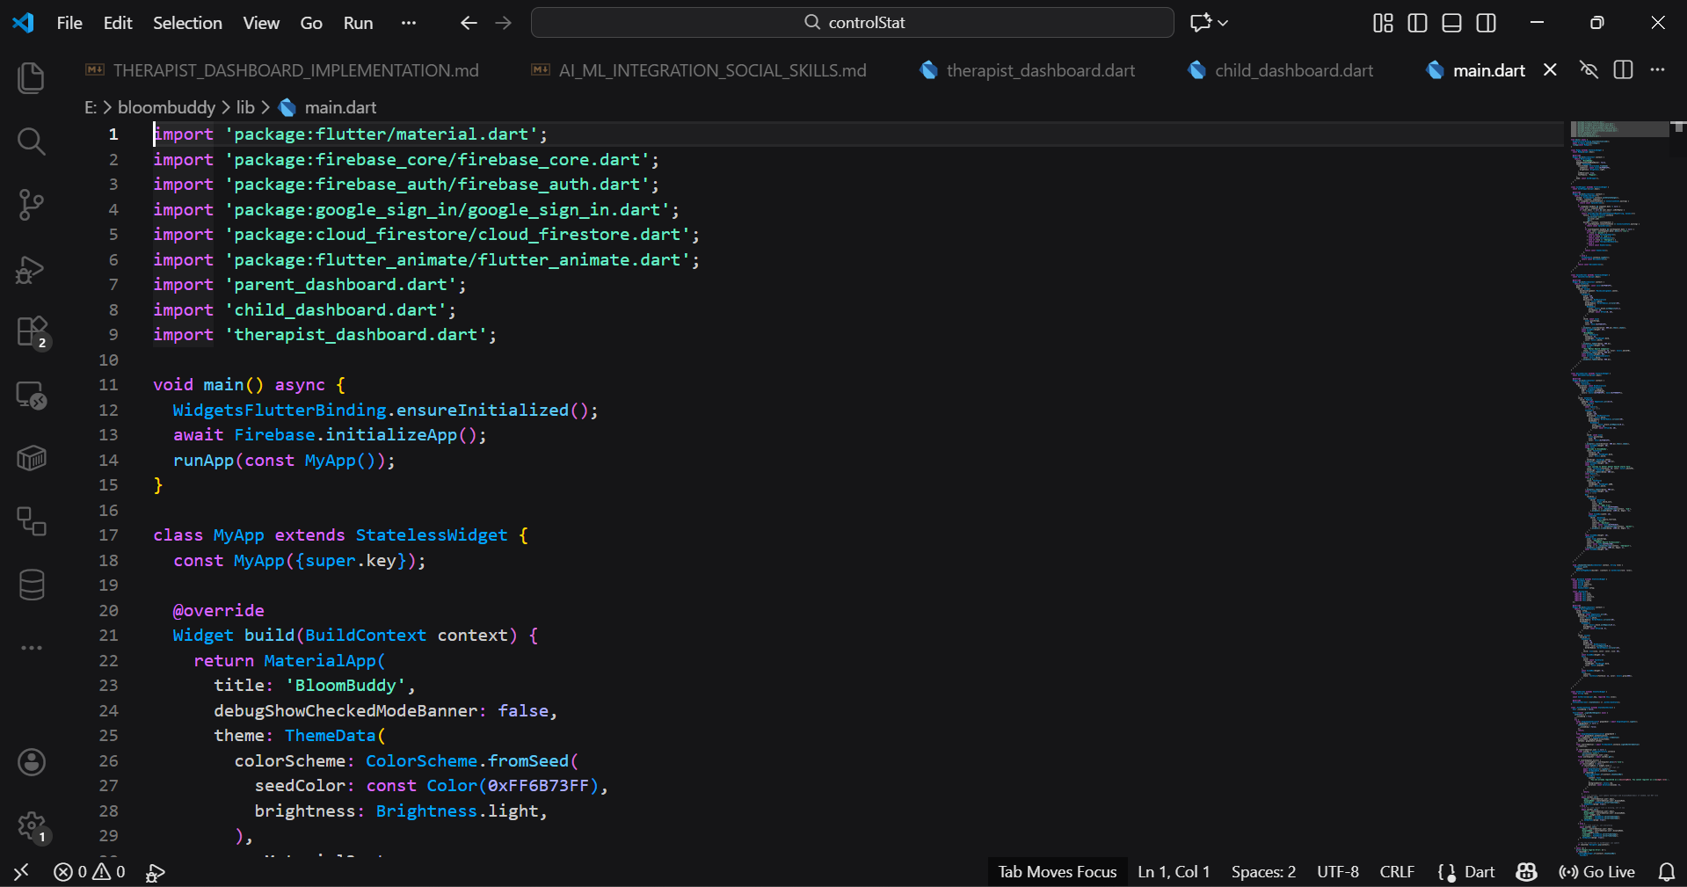
Implementation
ADAPTIVE TECHNOLOGY FOR AUTISM SUPPORT
Srinivasa Ramanujan Institute of Technology

Slide 11
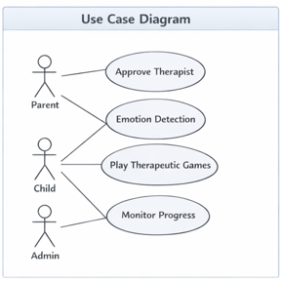
UML Diagram of Usecase:
ADAPTIVE TECHNOLOGY FOR AUTISM SUPPORT
The Parent approves therapist assignments and views emotion-related activities.
The Child interacts with the system by playing therapeutic games and participating in emotion detection.
The Admin monitors overall system usage and progress data.
The diagram shows how different users interact with the system based on their roles.
It highlights role-based access and responsibilities within the application.
Srinivasa Ramanujan Institute of Technology

Slide 12
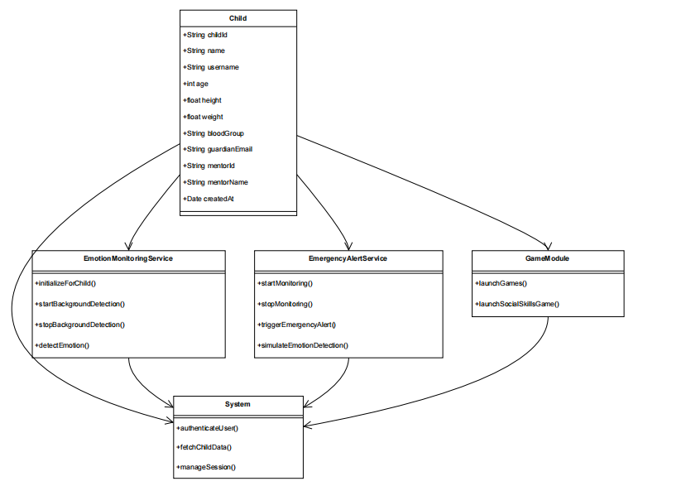
UML Diagram:
ADAPTIVE TECHNOLOGY FOR AUTISM SUPPORT
The Child class represents the primary user with personal and guardian-related details.
EmotionMonitoringService handles real-time and background emotion detection for the child.
EmergencyAlertService monitors critical emotions and triggers alerts to caregivers.
GameModule manages therapeutic and social skill games for the child.
The System class coordinates authentication, data retrieval, and session management.
Srinivasa Ramanujan Institute of Technology

Slide 13
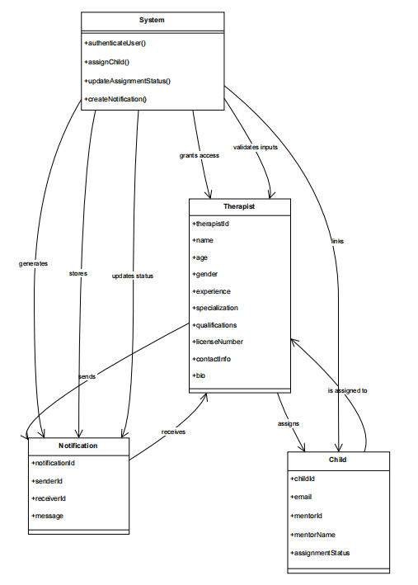
UML Diagram:
ADAPTIVE TECHNOLOGY FOR AUTISM SUPPORT
The System class manages authentication, child assignment, and notification creation.
The Therapist class stores professional details and handles assigned children.
The Child class maintains therapist assignment status and related details.
The Notification class manages messages sent during assignment and status updates.
The diagram shows how the system coordinates therapist assignment and communication.
Srinivasa Ramanujan Institute of Technology

Slide 14
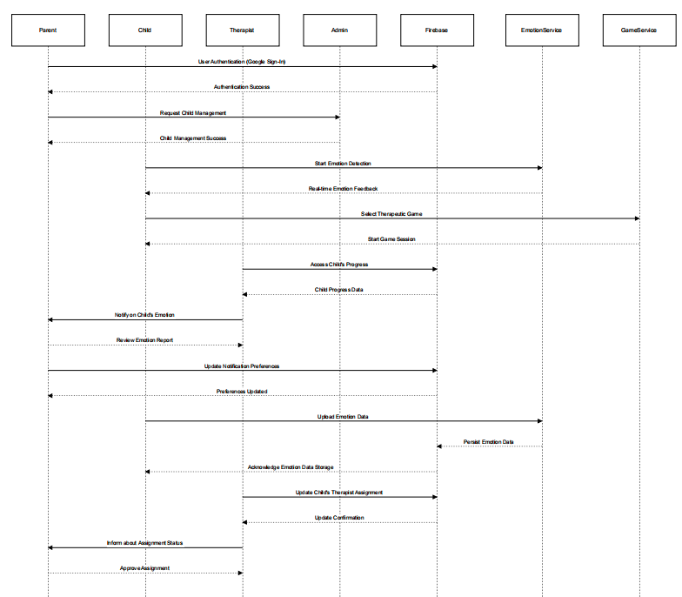
Sequence Diagram:
ADAPTIVE TECHNOLOGY FOR AUTISM SUPPORT
The user (Parent, Child, Therapist, or Admin) authenticates through Firebase services.
The system initiates emotion detection and provides real-time emotional feedback to the child.
The child selects and plays therapeutic games through the game service module.
Emotion data and activity progress are securely stored in Firebase.
Parents and therapists receive notifications and alerts based on emotional conditions.
Therapists access child progress data to monitor development and sessions.
Assignment updates and preferences are synchronized across the system in real time.
Srinivasa Ramanujan Institute of Technology

Slide 15
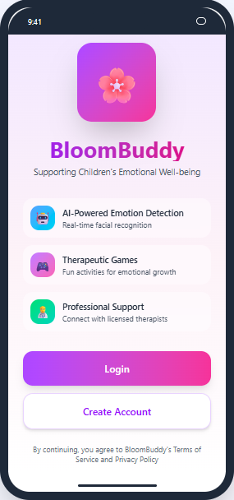
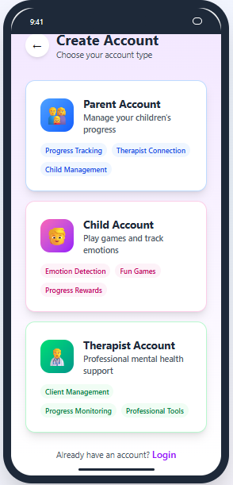
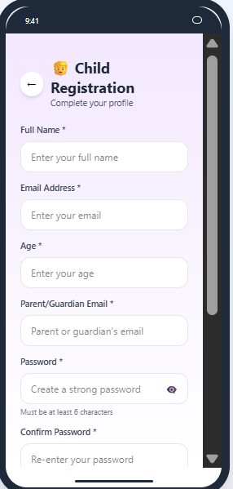
Outputs
ADAPTIVE TECHNOLOGY FOR AUTISM SUPPORT
Srinivasa Ramanujan Institute of Technology

Slide 16
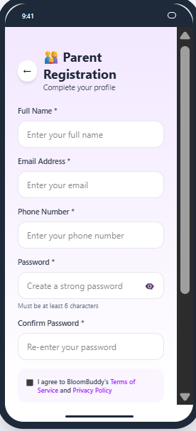
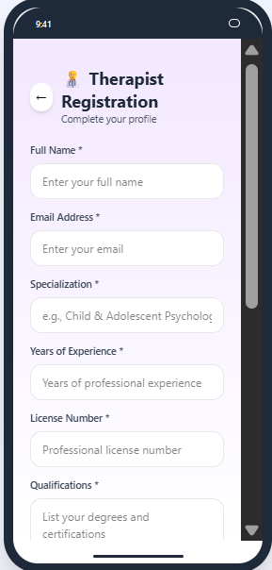
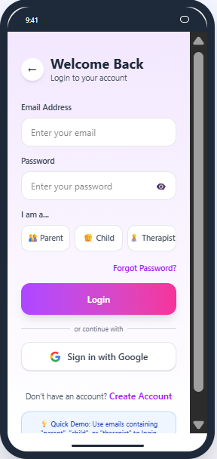
Outputs
ADAPTIVE TECHNOLOGY FOR AUTISM SUPPORT
Srinivasa Ramanujan Institute of Technology

Slide 17
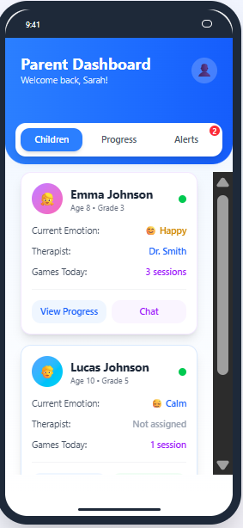
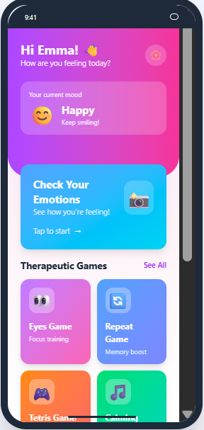
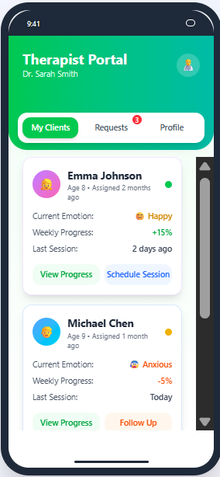
Outputs
ADAPTIVE TECHNOLOGY FOR AUTISM SUPPORT
Srinivasa Ramanujan Institute of Technology

Slide 18
References
ADAPTIVE TECHNOLOGY FOR AUTISM SUPPORT
[1]A. Holmgaard, H. Pedersen, and C. Abbott, “Animation: Children, Autism and New Possibilities for Learning,” PsykologCentret, Viborg, Denmark; VIA University, Denmark; King’s College London, UK, 2012.
[2] M. Elhaddadi, H. Maazouz, N. Alami, M. M. Drissi, C. S. Mènon, M. Latifi, and A. O. T. Ahami, “Serious Games to Teach Emotion Recognition to Children with Autism Spectrum Disorders (ASD),” International Journal of Computer Applications in Technology, 2019.
[3] A. Landowska, A. Karpus, T. Zawadzka, B. Robins, D. E. Barkana, H. Kose, T. Zorcec, and N. Cummins, “Automatic Emotion Recognition in Children with Autism: A Systematic Literature Review,” IEEE Transactions on Affective Computing, 2021.
Srinivasa Ramanujan Institute of Technology

Slide 19
Conclusion:
ADAPTIVE TECHNOLOGY FOR AUTISM SUPPORT
The project proposes an adaptive technology platform to support emotional and social development in children with autism.
Core functionalities such as authentication, emotion monitoring, therapeutic games, and progress tracking have been designed and implemented.
The system ensures privacy, role-based access, and secure data handling using Firebase services.
Future scope includes integrating advanced AI models for personalized adaptation and real-time analytics.
The platform can be extended with video therapy, multilingual support, and wider clinical validation.
Srinivasa Ramanujan Institute of Technology

Slide 20
ADAPTIVE TECHNOLOGY FOR AUTISM SUPPORT
Thank You
Srinivasa Ramanujan Institute of Technology

Slide 21
Conclusion:
ADAPTIVE TECHNOLOGY FOR AUTISM SUPPORT
Any Queries
Srinivasa Ramanujan Institute of Technology

